Slide 1
Chapter 22
How to use the DataGridView control

Slide 2
Objectives
Applied
Use a DataGridView control to display data from a data source.
Customize the appearance and operation of a DataGridView control.
Use paging with a DataGridView control.
Use a DataGridView control as part of a Master/Detail form.

Slide 3
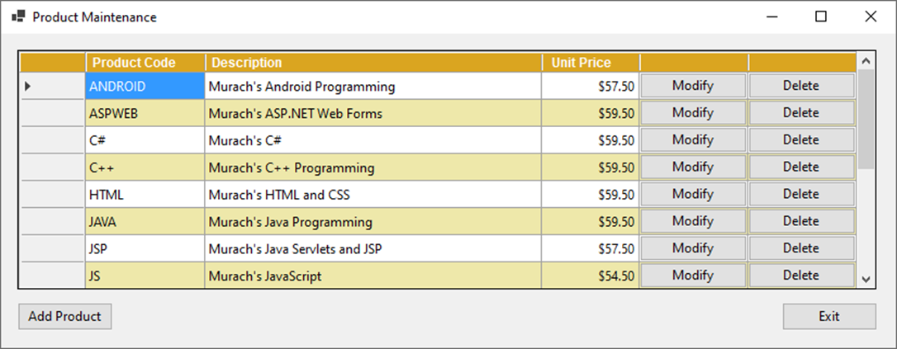
A DataGridView control that displays a list of products

Slide 4
Common properties of the DataGridView class
Rows
Columns
DataSource
Common method of the DataGridView class
AutoResizeColumns()

Slide 5
DataGridView control concepts
You can use a DataGridView control to display data in a row and column format. The intersection of a row and column is called a cell.
You can also use a DataGridView control to add, update, and delete data.
If the data source for a DataGridView control contains more rows and columns than can be displayed at one time, scrollbars are displayed.

Slide 6
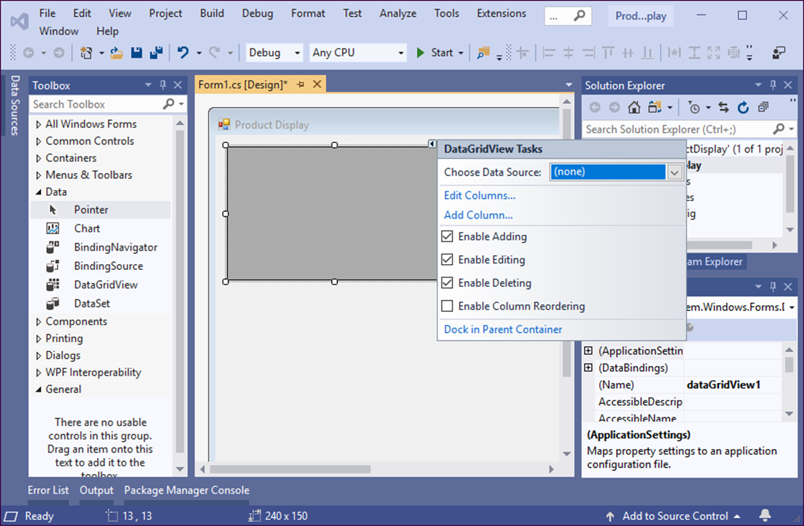
A DataGridView control after it’s added to a form

Slide 7
Properties that you can set from the smart tag menu
AllowUserToAddRows
AllowUserToDeleteRows
AllowUsersToOrderColumns
ReadOnly

Slide 8
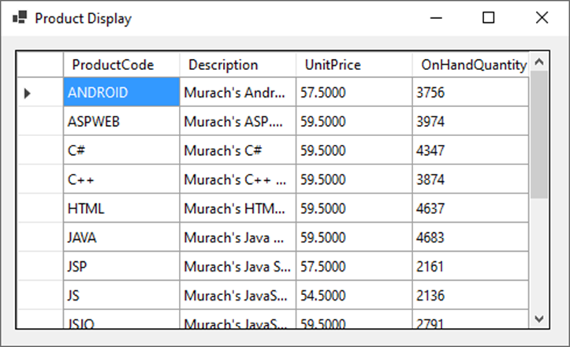
A DataGridView control that’s bound to a data source

Slide 9
How to bind a DataGridView control to an entity collection
MMABooksContext context = new MMABooksContext();
dgvProducts.DataSource = context.Products.ToList();
How to bind a DataGridView control to the results of a query
MMABooksContext context = new MMABooksContext();
var products = context.Products.OrderBy(
p => p.Description).Select(
p => new { p.ProductCode, p.Description, p.UnitPrice,
p.OnHandQuantity }).ToList();
dgvProducts.DataSource = products;
How to bind a DataGridView control to a list of objects created in code
List<Product> products = GetProducts();
dgvProducts.DataSource = products;

Slide 10
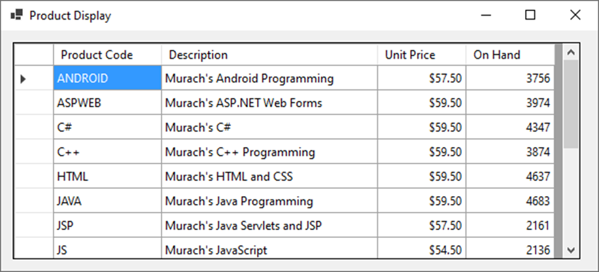
A DataGridView control after its columns are formatted

Slide 11
Common properties of the DataGridViewColumn class for formatting
HeaderText
Width
DefaultCellStyle
Common properties used for cell styles
Format
BackColor
ForeColor
Alignment
Font

Slide 12
Code that changes some of the formatting for the columns in a grid
dgvProducts.Columns[0].HeaderText = "Product Code";
dgvProducts.Columns[1].Width = 220;
dgvProducts.Columns[2].DefaultCellStyle.Format = "c";
dgvProducts.Columns[2].DefaultCellStyle.Alignment =
DataGridViewContentAlignment.MiddleRight;

Slide 13
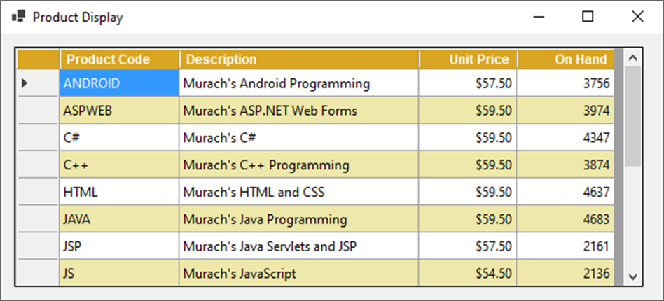
A DataGridView control after its headers and rows are formatted

Slide 14
Common properties of the DataGridView class for formatting
EnableHeadersVisualStyles
ColumnHeadersDefaultCellStyle
AlternatingRowsDefaultCellStyle
Common properties of the DataGridViewColumn class for formatting headers
SortMode
HeaderCell
Common property of the DataGridViewCell class for formatting
Style

Slide 15
Code that changes some of the formatting for a grid
dgvProducts.EnableHeadersVisualStyles = false;
dgvProducts.ColumnHeadersDefaultCellStyle.Font =
new Font("Arial", 9, FontStyle.Bold);
dgvProducts.AlternatingRowsDefaultCellStyle.BackColor =
Color.PaleGoldenrod;
dgvProducts.Columns[2].SortMode =
DataGridViewColumnSortMode.NotSortable;
dgvProducts.Columns[2].HeaderCell.Style.Alignment =
DataGridViewContentAlignment.MiddleRight;

Slide 16
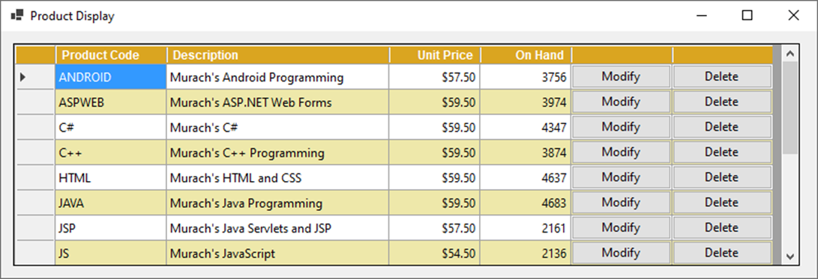
A DataGridView control with two button columns

Slide 17
Common properties of the DataGridViewButtonColumn class
HeaderText
Text
UseColumnTextForButtonValue
Common methods of the DataGridViewColumnCollection class
Add(column)
Insert(index, column)
Remove(column)
RemoveAt(index)

Slide 18
Code that adds a button column to a DataGridView control
DataGridViewButtonColumn deleteColumn =
new DataGridViewButtonColumn();
deleteColumn.HeaderText = "";
deleteColumn.UseColumnTextForButtonValue = true;
deleteColumn.Text = "Delete";
dgvProducts.Columns.Add(deleteColumn);
A statement that deletes a column from a DataGridView control
dgvProducts.Columns.RemoveAt(4);

Slide 19
Properties of the DataGridViewCellEventArgs class
RowIndex
ColumnIndex
A property of the DataGridViewRow class
Cells
A property of the DataGridViewCell class
Value

Slide 20
Code that handles the CellClick event of a DataGridView control
private Products selectedProduct;
private void dgvProducts_CellClick(object sender,
DataGridViewCellEventArgs e)
{
const int ModifyIndex = 3;
const int DeleteIndex = 4;
if (e.ColumnIndex == ModifyIndex ||
e.ColumnIndex == DeleteIndex)
{
string productCode =
dgvProducts.Rows[e.RowIndex].Cells[0]
.Value.ToString().Trim();
selectedProduct = context.Products.Find(productCode);
}
if (e.ColumnIndex == ModifyIndex)
ModifyProduct();
else if (e.ColumnIndex == DeleteIndex)
DeleteProduct();
}

Slide 21

The Product Maintenance form

Slide 22
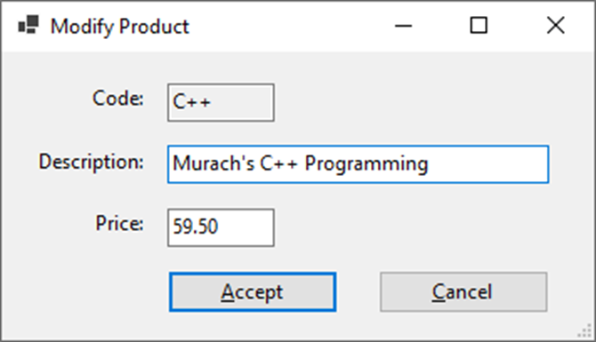
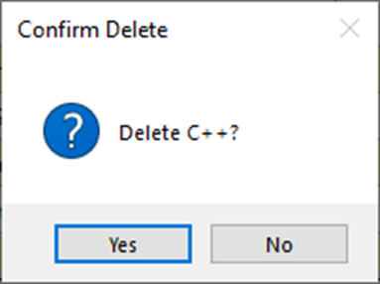
The Add/Modify Product form
The dialog box for confirming a delete operation

Slide 23
Code for the Product Maintenance form (part 1)
private MMABooksContext context = new MMABooksContext();
private Products selectedProduct;
private void frmProductMaintenance_Load(object sender, EventArgs e)
{
DisplayProducts();
}
private void DisplayProducts()
{
dgvProducts.Columns.Clear();
var products = context.Products
.OrderBy(p => p.Description)
.Select(p => new { p.ProductCode, p.Description,
p.UnitPrice }).ToList();
dgvProducts.DataSource = products;
// add column for modify button
var modifyColumn = new DataGridViewButtonColumn() {
UseColumnTextForButtonValue = true,
HeaderText = "",
Text = "Modify"
};
dgvProducts.Columns.Add(modifyColumn);

Slide 24
Code for the Product Maintenance form (part 2)
// add column for delete button
var deleteColumn = new DataGridViewButtonColumn() {
UseColumnTextForButtonValue = true,
HeaderText = "",
Text = "Delete"
};
dgvProducts.Columns.Add(deleteColumn);
// format the column headers
dgvProducts.EnableHeadersVisualStyles = false;
dgvProducts.ColumnHeadersDefaultCellStyle.Font =
new Font("Arial", 9, FontStyle.Bold);
dgvProducts.ColumnHeadersDefaultCellStyle.BackColor = Color.Goldenrod;
dgvProducts.ColumnHeadersDefaultCellStyle.ForeColor = Color.White;
// format the odd numbered rows
dgvProducts.AlternatingRowsDefaultCellStyle.BackColor =
Color.PaleGoldenrod;
// format the first column
dgvProducts.Columns[0].HeaderText = "Product Code";
dgvProducts.Columns[0].Width = 110;
// format the second column
dgvProducts.Columns[1].Width = 310;

Slide 25
Code for the Product Maintenance form (part 3)
// format the third column
dgvProducts.Columns[2].HeaderText = "Unit Price";
dgvProducts.Columns[2].HeaderCell.Style.Alignment =
DataGridViewContentAlignment.MiddleRight;
dgvProducts.Columns[2].Width = 90;
dgvProducts.Columns[2].DefaultCellStyle.Format = "c";
dgvProducts.Columns[2].DefaultCellStyle.Alignment =
DataGridViewContentAlignment.MiddleRight;
}
private void dgvProducts_CellClick(object sender,
DataGridViewCellEventArgs e)
{
// store index values for Modify and Delete button columns
const int ModifyIndex = 3;
const int DeleteIndex = 4;
if (e.ColumnIndex == ModifyIndex || e.ColumnIndex == DeleteIndex) {
string productCode =
dgvProducts.Rows[e.RowIndex].Cells[0].Value.ToString().Trim();
selectedProduct = context.Products.Find(productCode);
}
if (e.ColumnIndex == ModifyIndex)
ModifyProduct();
else if (e.ColumnIndex == DeleteIndex)
DeleteProduct();
}

Slide 26
Code for the Product Maintenance form (part 4)
private void ModifyProduct()
{
var addModifyProductForm = new frmAddModifyProduct() {
AddProduct = false,
Product = selectedProduct
};
DialogResult result = addModifyProductForm.ShowDialog();
if (result == DialogResult.OK)
{
try {
selectedProduct = addModifyProductForm.Product;
context.SaveChanges();
DisplayProducts();
}
catch (DbUpdateConcurrencyException ex) {
HandleConcurrencyError(ex);
}
catch (DbUpdateException ex) {
HandleDatabaseError(ex);
}
catch (Exception ex) {
HandleGeneralError(ex);
}
}
}

Slide 27
Code for the Product Maintenance form (part 5)
private void DeleteProduct()
{
DialogResult result =
MessageBox.Show($"Delete {selectedProduct.ProductCode.Trim()}?",
"Confirm Delete", MessageBoxButtons.YesNo, MessageBoxIcon.Question);
if (result == DialogResult.Yes)
{
try {
context.Products.Remove(selectedProduct);
context.SaveChanges(true);
DisplayProducts();
}
catch (DbUpdateConcurrencyException ex) {
HandleConcurrencyError(ex);
}
catch (DbUpdateException ex) {
HandleDatabaseError(ex);
}
catch (Exception ex) {
HandleGeneralError(ex);
}
}
}

Slide 28
Code for the Product Maintenance form (part 6)
private void btnAdd_Click(object sender, EventArgs e)
{
var addModifyProductForm = new frmAddModifyProduct() {
AddProduct = true
};
DialogResult result = addModifyProductForm.ShowDialog();
if (result == DialogResult.OK)
{
try {
selectedProduct = addModifyProductForm.Product;
context.Products.Add(selectedProduct);
context.SaveChanges();
DisplayProducts();
}
catch (DbUpdateException ex) {
HandleDatabaseError(ex);
}
catch (Exception ex) {
HandleGeneralError(ex);
}
}
}

Slide 29
Code for the Product Maintenance form (part 7)
private void HandleConcurrencyError(DbUpdateConcurrencyException ex) { ... }
private void HandleDatabaseError(DbUpdateException ex) { ... }
private void HandleGeneralError(Exception ex) { ... }
private void btnExit_Click(object sender, EventArgs e)
{
this.Close();
}

Slide 30
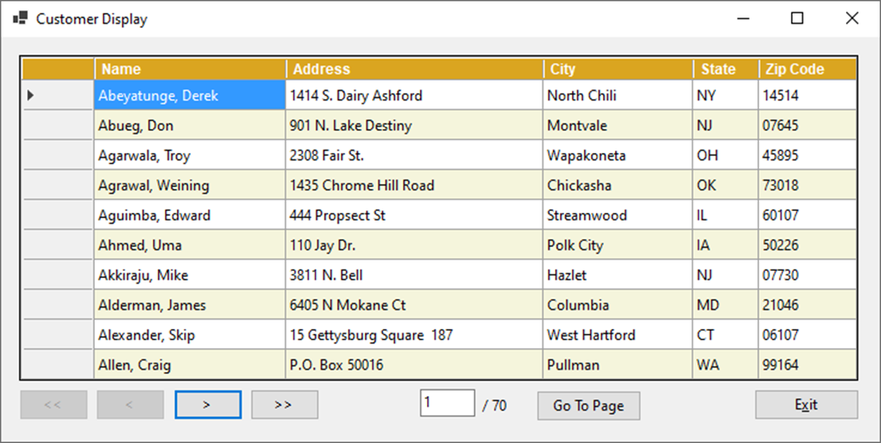
A Customer Display form that provides for paging

Slide 31
The code that implements the paging (part 1)
private MMABooksContext context = new MMABooksContext();
private const int MaxRows = 10;
private int totalRows = 0;
private int pages = 0;
private void frmCustDisplay_Load(object sender, EventArgs e)
{
totalRows = context.Customers.Count();
pages = totalRows / MaxRows;
if (totalRows % MaxRows != 0)
{
pages += 1;
}
lblPages.Text = "/ " + pages;
DisplayCustomers(1);
}

Slide 32
The code that implements the paging (part 2)
private void DisplayCustomers(int pageNumber)
{
txtPage.Text = pageNumber.ToString();
int skip = MaxRows * (pageNumber - 1);
int take = MaxRows;
if (pageNumber == pages)
{
take = totalRows - skip;
}
if (totalRows <= MaxRows)
{
take = totalRows;
}

Slide 33
The code that implements the paging (part 3)
var customers = context.Customers
.OrderBy(c => c.Name)
.Select(c => new { c.Name, c.Address, c.City,
c.State, c.ZipCode })
.Skip(skip)
.Take(take)
.ToList();
dgvCustomers.DataSource = customers;
// Code that formats the DataGridView control goes here
EnableDisableButtons(pageNumber);
}
private void EnableDisableButtons(int pageNumber)
{
if (pageNumber == 1) {
btnFirst.Enabled = false;
btnPrev.Enabled = false;
}
else {
btnFirst.Enabled = true;
btnPrev.Enabled = true;
}

Slide 34
The code that implements the paging (part 4)
if (pageNumber == pages) {
btnNext.Enabled = false;
btnLast.Enabled = false;
}
else {
btnNext.Enabled = true;
btnLast.Enabled = true;
}
// if there's only one page, disable the Go To button
if (totalRows <= MaxRows) {
btnGoTo.Enabled = false;
}
}
private void btnFirst_Click(object sender, EventArgs e)
{
DisplayCustomers(1);
}

Slide 35
The code that implements the paging (part 5)
private void btnPrev_Click(object sender, EventArgs e)
{
int pageNumber = Convert.ToInt32(txtPage.Text);
pageNumber -= 1;
DisplayCustomers(pageNumber);
}
private void btnNext_Click(object sender, EventArgs e)
{
int pageNumber = Convert.ToInt32(txtPage.Text);
pageNumber += 1;
DisplayCustomers(pageNumber);
}
private void btnLast_Click(object sender, EventArgs e)
{
DisplayCustomers(pages);
}

Slide 36
The code that implements the paging (part 6)
private void btnGoTo_Click(object sender, EventArgs e)
{
if (IsValidData())
{
int pageNumber = Convert.ToInt32(txtPage.Text);
DisplayCustomers(pageNumber);
}
}

Slide 37
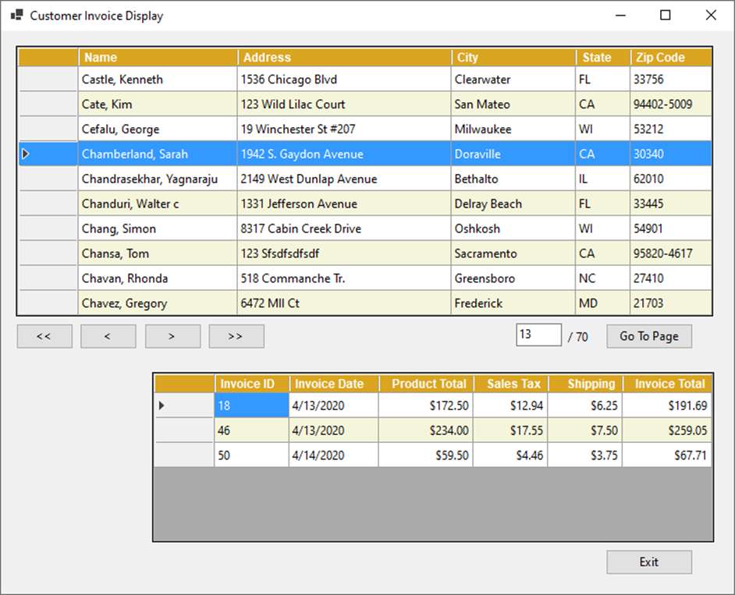
A Master/Detail form with customers and invoices

Slide 38
The code for the Master/Detail form (part 1)
...
private void DisplayCustomers(int pageNumber)
{
...
var customers = context.Customers
.OrderBy(c => c.Name)
.Select(c => new { c.CustomerId, c.Name, c.Address,
c.City, c.State, c.ZipCode })
.Skip(skip)
.Take(take)
.ToList();
dgvCustomers.DataSource = customers;
// select the first row of the page and display its invoices
dgvCustomers.Rows[0].Selected = true;
DisplayInvoices(0);
// format customer grid
...
dgvCustomers.Columns[0].Visible = false; // hide id column
...
}
...

Slide 39
The code for the Master/Detail form (part 2)
private void dgvCustomers_RowHeaderMouseClick(object sender,
DataGridViewCellMouseEventArgs e)
{
DisplayInvoices(e.RowIndex);
}
private void DisplayInvoices(int rowIndex)
{
DataGridViewRow row = dgvCustomers.Rows[rowIndex];
int customerID = Convert.ToInt32(row.Cells[0].Value);
var invoices = context.Invoices
.Where(i => i.CustomerId == customerID)
.OrderBy(i => i.InvoiceId)
.Select(i => new { i.InvoiceId, i.InvoiceDate,
i.ProductTotal, i.SalesTax,
i.Shipping, i.InvoiceTotal })
.ToList();
dgvInvoices.DataSource = invoices;
// format the invoices grid
}

Slide 40
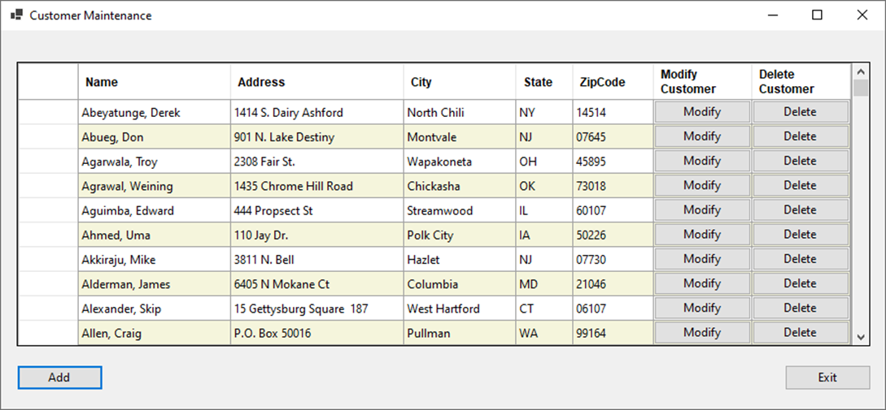
Exercise 22-1 Create a Customer Maintenance application that uses a grid
Develop an application that uses a DataGridView control to display, modify, and delete data in a table of customers.

Slide 41
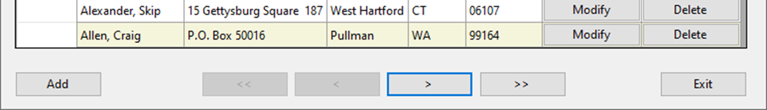
Exercise 22-2 Add paging to the Customer Maintenance application
Add paging for the DataGridView control used by the Customer Maintenance application of exercise 22-1.

Slide 42
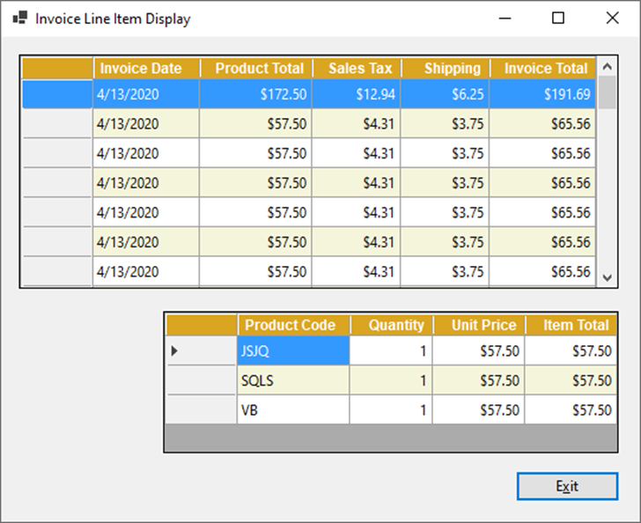
Exercise 22-3 Create an Invoice Line Item Display application
Develop an application that uses DataGridView controls to display invoices and the line items for the selected invoice.

Slide 43
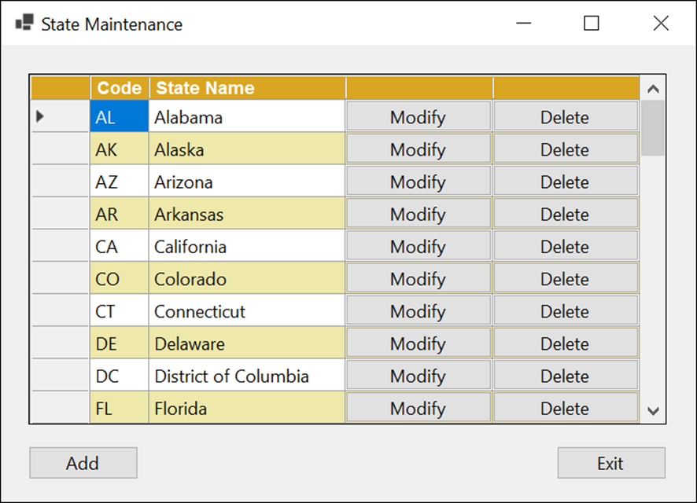
Extra 22-1 Create an application that uses a DataGridView control (part 1)
Develop an application that uses a DataGridView control to display, modify, and delete data in a table of states.

Slide 44
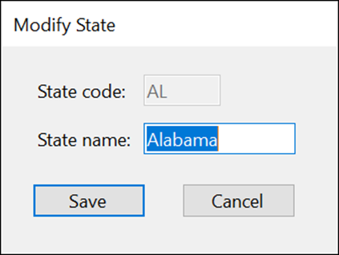
Extra 22-1 Create an application that uses a DataGridView control (part 2)
Add the code that modifies a state when a Modify button is clicked.

Slide 45
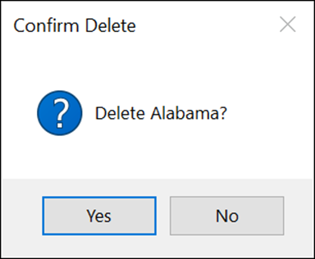
Extra 22-1 Create an application that uses a DataGridView control (part 3)
Add the code that deletes a state when a Delete button is clicked.

Slide 46
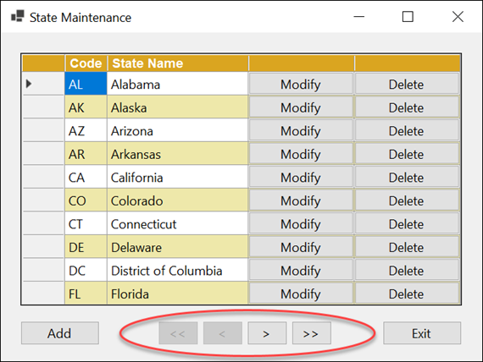
Extra 22-2 Add paging to an application
Add paging for the DataGridView control used by the State Maintenance application of extra exercise 22-1.

Slide 47
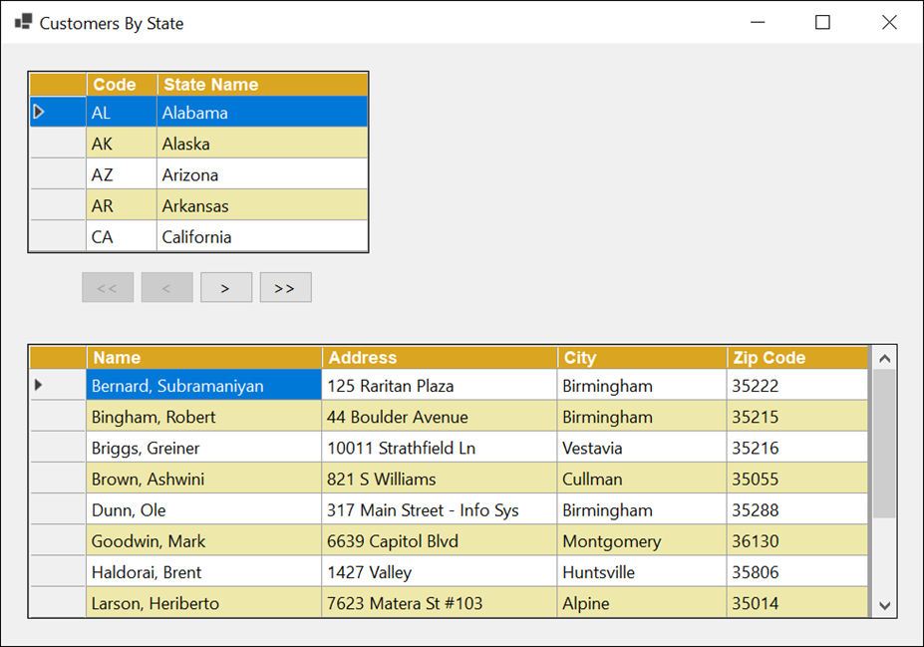
Extra 22-3 Create a Master/Detail form
Develop an application that uses DataGridView controls to display the states using paging and the customers for the selected state.

Slide 48
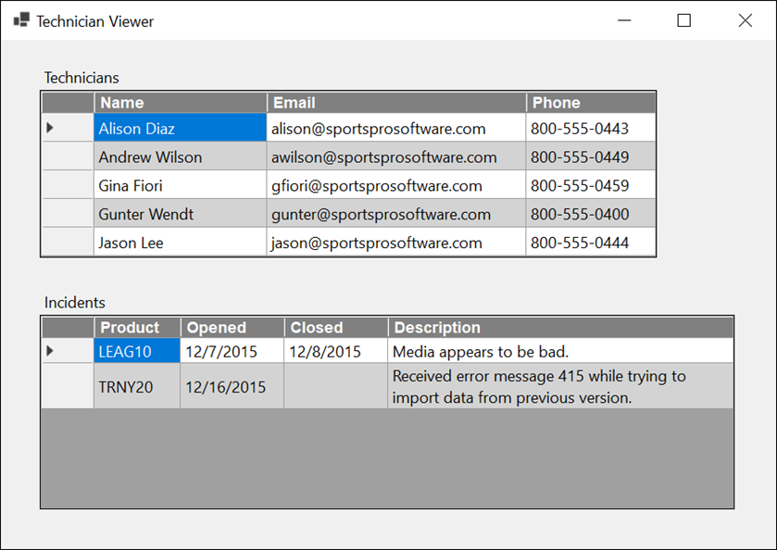
Project 5-3 Display technicians and incidents in a master/details form
Develop an application that uses DataGridView controls to display technicians and the incidents for the selected technician.

Slide 49
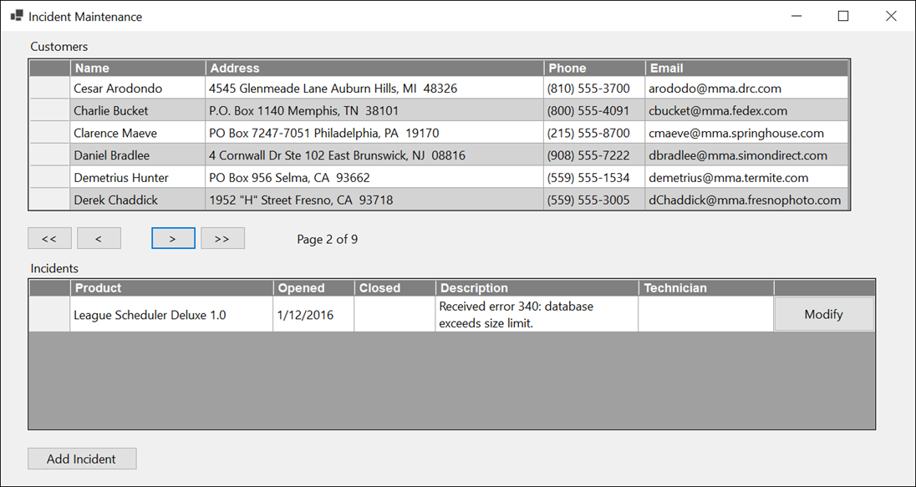
Project 5-4 Maintain incidents (part 1)
Develop an application that uses DataGridView controls to display customers using paging and display and modify incidents for the selected customer. The form should also provide for adding incidents.

Slide 50
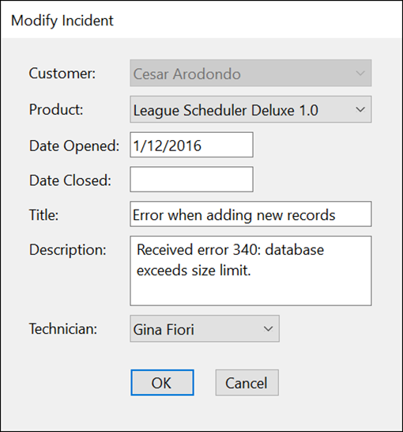
Project 5-4 Maintain incidents (part 2)
Develop a form that lets users add or modify an incident.

